Slide 1
Module 3
Database Services

Slide 2
Module 3
Relational databases, Amazon RDS, Amazon Redshift, Nonrelational Databases (NoSQL), Dynamo DB

Slide 3
Relational Databases
A relational database contains at least one table, which you can visualize as a spreadsheet with columns and rows.
In a relational database table, columns may also be called attributes, and rows may also be called records or tuples.
Columns and Attributes
Before you can add data to a relational database table, you must predefine each column’s name and what data types it can accept.
Columns are ordered, and you can’t change the order after you create the table. The ordering creates a relationship between attributes in the table, which is where the term relational database comes from.
Refer to Table 5.1 for an example of a relational database table containing employee records.

Slide 4
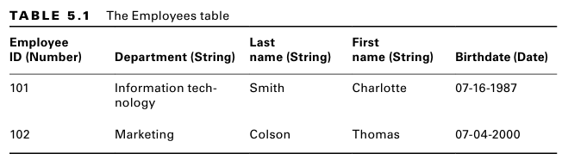

Slide 5
Data must match the type defined under each column.
For example, the Employee ID can’t be a letter, because it’s defined as a numeric data type.
One advantage of a relational database is that it allows for flexible queries—you don’t have to understand up front how you’re going to query the data.
As long as the data is there in a consistent format, you can craft queries to get the data you want, the way you want.
This makes relational databases good for applications that need to query data in arbitrary columns and customize how that data is presented.
For example, you could query the database to return the birthdate of every employee whose first name is Charlotte.
Or you could query the database for every employee with a birthday in July. Relational databases make getting the data you want fast and easy.

Slide 6
Another advantage is that you can add more columns to a table after creating it.
You can also delete columns, but deleting a column entails deleting all the data stored under the column.
If you delete the First Name column, it will remove first name data for all employees in the table.
Using Multiple Tables
Storing all data in a single table can lead to unnecessary duplication, needlessly increasing the size of the database and making queries slower.
Hence, it’s common for applications to use multiple related tables.
Using the preceding example, if 50 employees work in the information technology department, the string “Information technology” appears in the table 50 times—once for each record.
To avoid this wasted space, you may create a separate table to hold department names, as shown in Table 5.2

Slide 7
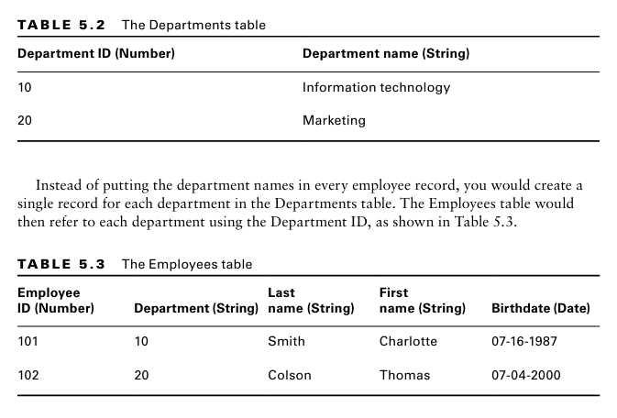

Slide 8
In this relationship, the Departments table is the parent table, and the Employees table is the child table.
Each value in the Department column in the Employees table refers to the Department ID in the Departments table.
Notice that the data type for the Department column is still a string. Although you could change the data type to a number, it’s not necessary.
The Department ID in the Departments table is called the primary key, and it must be unique in the table so that it can uniquely identify a row.
The Employees table refers to the Department ID as a foreign key.
You must define primary and foreign keys so that the database knows how the columns in different tables are related.
The database will enforce foreign key constraints to ensure that when a child table references a foreign key, that key also exists in the parent.

Slide 9
Structured Query Language
You use the Structured Query Language (SQL) with relational databases to store and query data and perform database maintenance tasks.
For this reason, relational databases are often called SQL databases. SQL commands or statements differ slightly depending on the specific relational data base management system (RDBMS) you’re using.
All major programming languages have libraries that construct SQL statements and interact with the database, so you don’t need to master SQL.
But you do need to understand the concepts behind a few common SQL terms.

Slide 10
Querying Data
The SELECT statement is used to query data from a SQL database.
It allows you to query based on the value in any column, as well as specify the specific columns you want the database to return.
Thanks to the predictable structure of tables and the enforcement of foreign key constraints, you can use a JOIN clause with a SELECT statement to join together data from different tables.

Slide 11
Storing Data
The INSERT statement allows you to insert data directly into a table. For example, when adding new customer information to a customer relationship management (CRM) application, the application is probably using a SQL INSERT on the backend to add the customer data to a table.
If you need to load a large number of records into a database, you can use the COPY command to copy data from a properly formatted file into the table you specify.

Slide 12
Online Transaction Processing vs. Online Analytic Processing
A relational database can be optimized for fast, frequent transactions, or it can be optimized for large, complex queries.
Depending on its configuration, a relational database can fall into one of two categories: online transaction processing (OLTP) or online analytic processing (OLAP)

Slide 13
OLTP
OLTP databases are suited to applications that read and write data frequently, on the order of multiple times per second.
They are optimized for fast queries, and those queries tend to be regular and predictable.
Depending on the size of the database and its performance requirements, an OLTP database may have intense memory requirements so that it can store frequently accessed portions of tables in memory for quick access.
Generally, a single server with ample memory and compute power handles all writes to an OLTP database.
An OLTP database would be a good candidate for backing an online ordering system that processes hundreds of orders a minute.

Slide 14
OLAP
OLAP databases are optimized for complex queries against large data sets.
As a result, OLAP databases tend to have heavy compute and storage requirements. In data warehousing applications, it’s common to aggregate multiple OLTP databases into a single OLAP database.
For example, in an OLTP database for an employee management system, employee data may be spread out across multiple tables.
At regular but infrequent inter vals, a data warehouse would aggregate these tables into a single table in an OLAP data base.
This makes it easier to structure SQL queries against the data. It also reduces the amount of time it takes to process such a computationally intensive query by offloading it to the high-powered OLAP database.
With a large OLAP database, it’s common for multiple database servers to share the computational load of complex queries.
In a process called partitioning or sharding, each server gets a portion of the database for which it’s responsible

Slide 15
Amazon Relational Database Service
Amazon Relational Database Service (RDS) is a managed database service that lets you run relational database systems in the cloud.
RDS takes care of setting up the database system, performing backups, ensuring high availability, and patching the database software and the underlying operating system.
RDS also makes it easy to recover from database failures, restore data, and scale your databases to achieve the level of performance and avail ability that your application requires.
To deploy a database using RDS, you start by configuring a database instance, which is an isolated database environment.
A database instance exists in a virtual private cloud (VPC) that you specify, but unlike an EC2 instance, AWS fully manages database instances.
You can’t establish an SSH session to them, and they don’t show up under your EC2 instances

Slide 16
Database Engines
A database engine is simply the software that stores, organizes, and retrieves data in a data base. Each database instance runs only one database engine. RDS offers the following six database engines to choose from:
MySQL: MySQL is designed for OLTP applications such as blogs and e-commerce. RDS offers the latest MySQL Community Edition versions. MySQL offers two storage engines—MyISAM and InnoDB—but you should use the latter as it’s the only one compatible with RDS-managed automatic backups.
MariaDB: MariaDB is a drop-in binary replacement for MySQL. It was created over concerns about MySQL’s future after Oracle acquired the company that developed it. MariaDB supports the XtraDB and InnoDB storage engines, but AWS recommends using the latter for maximum compatibility with RDS.

Slide 17
Oracle Oracle is one of the most widely deployed relational database management systems. Some applications expressly require an Oracle database.
RDS provides the fol lowing Oracle Database editions:
Standard Edition One (SE1) Standard Edition Two (SE2) Standard Edition (SE) Enterprise Edition (EE)
PostgreSQL PostgreSQL advertises itself as the most Oracle-compatible open source database. This is a good choice when you have in-house applications that were devel oped for Oracle but want to keep costs down.
Amazon Aurora Aurora is Amazon’s drop-in binary replacement for MySQL and PostgreSQL. Aurora offers better write performance than both by using a virtualized storage layer that reduces the number of writes to the underlying storage.
It provides two editions:
MySQL compatible
PostgreSQL compatible

Slide 18
Depending on the edition you choose, Aurora is compatible with PostgreSQL or MySQL import and export tools and snapshots.
Aurora is designed to let you seamlessly migrate from an existing deployment that uses either of those two open source databases.
For MySQL-compatible editions, Aurora supports only the InnoDB storage engine. Also, the Aurora Backtrack feature for MySQL lets you, within a matter of sec onds, restore your database to any point in time within the last 72 hours.
Microsoft SQL Server RDS offers multiple Microsoft SQL Server versions ranging from 2012 to the present. For the edition, you can choose Express, Web, Standard, or Enterprise. The variety of flavors makes it possible to migrate an existing SQL Server database from an on-premises deployment to RDS without having to perform any data base upgrades.

Slide 19
Licensing Considerations
RDS provides two models for licensing the database engine software you run.
The license included model covers the cost of the license in the pricing for an RDS instance.
The bring your own license (BYOL) model requires you to obtain a license for the database engine you run.
License Included MariaDB and MySQL use the GNU General Public License (GPL) v2.0, and PostgreSQL uses the PostgreSQL license, all of which allow for free use of the respective software.

Slide 20
Create an RDS Database Instance
1. Go to the RDS Dashboard.
2. Click Create Database.
3. Under Choose A Database Creation Method, select Standard Create.
4. Under Engine Options, select MariaDB. Keep the default version.
5. Under Templates, select Free Tier.
6. Enter a master username and master password of your choice.
7. Scroll down to the Additional Configuration section and expand it.
8. For Initial Database Name, enter a database name of your choice.
9. Click Create Database

Slide 21
DynamoDB

Slide 22
What is Amazon DynamoDB?
Amazon DynamoDB is a fully managed NoSQL database service that provides fast and predictable performance with seamless scalability.
DynamoDB lets you offload the administrative burdens of operating and scaling a distributed database so that you don't have to worry about hardware provisioning, setup and configuration, replication, software patching, or cluster scaling.
DynamoDB also offers encryption at rest, which eliminates the operational burden and complexity involved in protecting sensitive data.

Slide 23
Getting started with DynamoDB
Topics
Basic concepts in DynamoDB
Prerequisites - getting started tutorial
Step 1: Create a table
Step 2: Write data to a table using the console or AWS CLI
Step 3: Read data from a table
Step 4: Update data in a table
https://docs.aws.amazon.com/amazondynamodb/latest/developerguide/GettingStartedDynamoDB.html

Slide 24
Core components of Amazon DynamoDB
In DynamoDB, tables, items, and attributes are the core components that you work with.
A table is a collection of items, and each item is a collection of attributes. DynamoDB uses primary keys to uniquely identify each item in a table and secondary indexes to provide more querying flexibility.
You can use DynamoDB Streams to capture data modification events in DynamoDB tables.

Slide 25
Tables, items, and attributes
The following are the basic DynamoDB components:
Tables – Similar to other database systems, DynamoDB stores data in tables. A table is a collection of data.
Items – Each table contains zero or more items. An item is a group of attributes that is uniquely identifiable among all of the other items. In a People table, each item represents a person. For a Cars table, each item represents one vehicle. Items in DynamoDB are similar in many ways to rows, records, or tuples in other database systems. In DynamoDB, there is no limit to the number of items you can store in a table.
Attributes – Each item is composed of one or more attributes. An attribute is a fundamental data element, something that does not need to be broken down any further. For example, an item in a People table contains attributes called PersonID, LastName, FirstName, and so on. For a Department table, an item might have attributes such as DepartmentID, Name, Manager, and so on. Attributes in DynamoDB are similar in many ways to fields or columns in other database systems.

Slide 26
Setting up DynamoDB
To use the DynamoDB service, you must have an AWS account. If you don't already have an account, you are prompted to create one when you sign up. You're not charged for any AWS services that you sign up for unless you use them.
To sign up for AWS
Open https://portal.aws.amazon.com/billing/signup.
Follow the online instructions.
Part of the sign-up procedure involves receiving a phone call and entering a verification code on the phone keypad.
When you sign up for an AWS account, an AWS account root user is created. The root user has access to all AWS services and resources in the account. As a security best practice, assign administrative access to an administrative user, and use only the root user to perform tasks that require root user access.

Slide 27
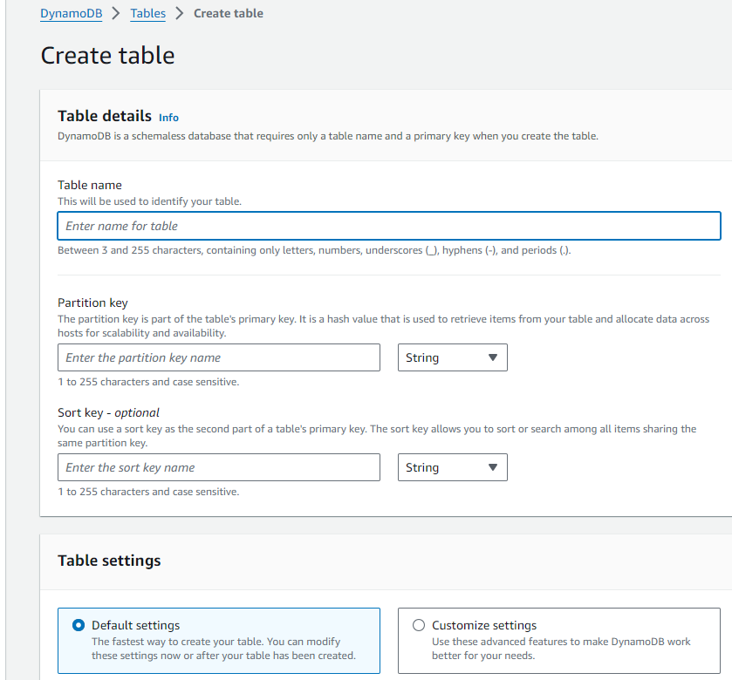
Create a table

Slide 28
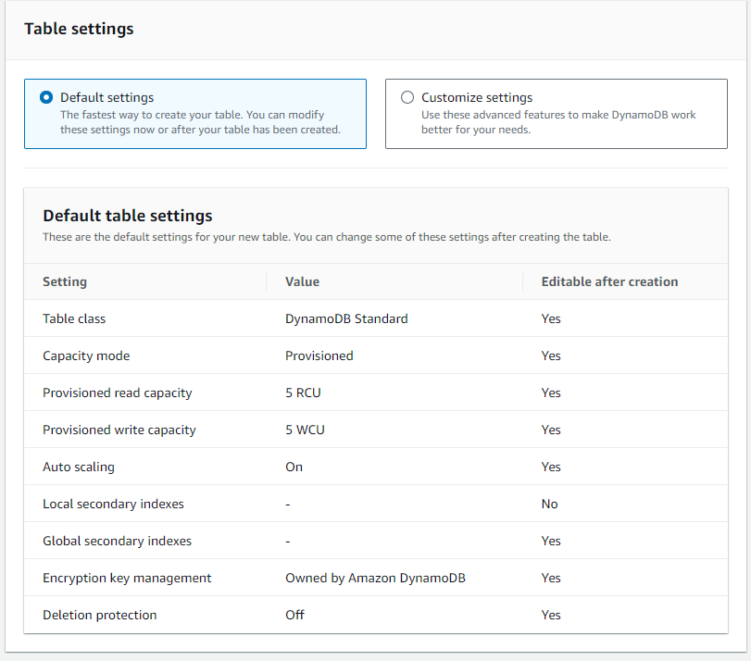

Slide 29
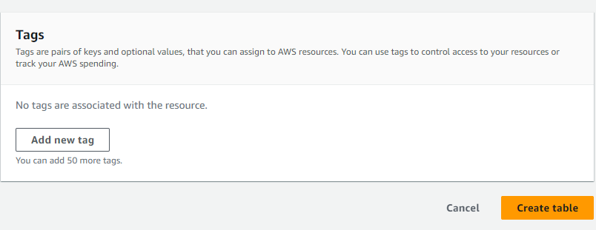

Slide 30
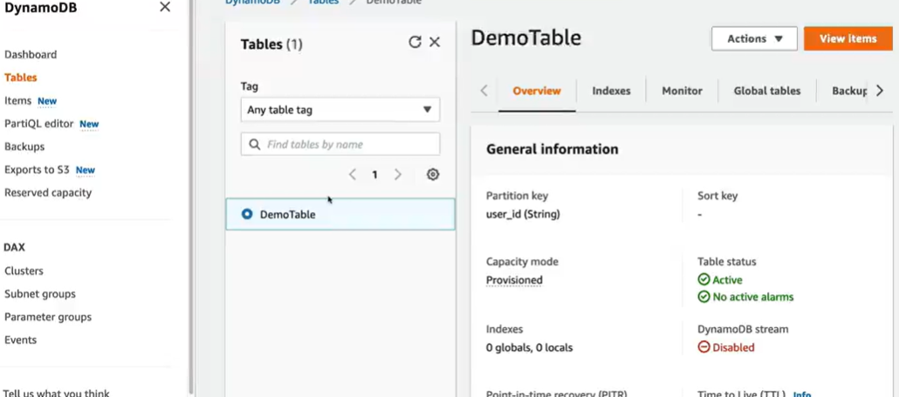
Click on view items

Slide 31
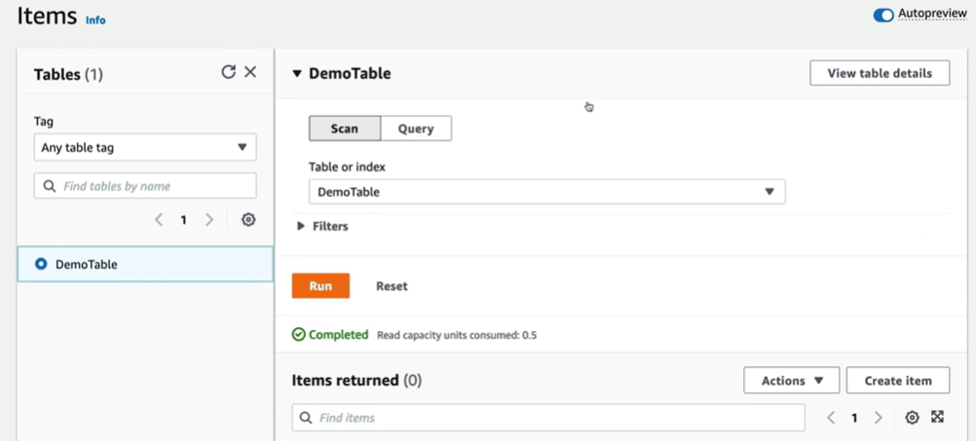
Can create item

Slide 32
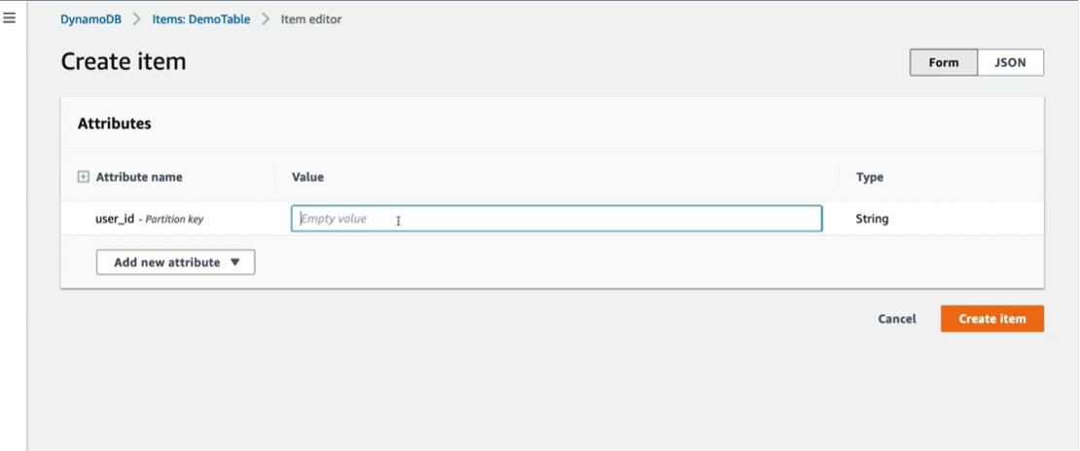

Slide 33
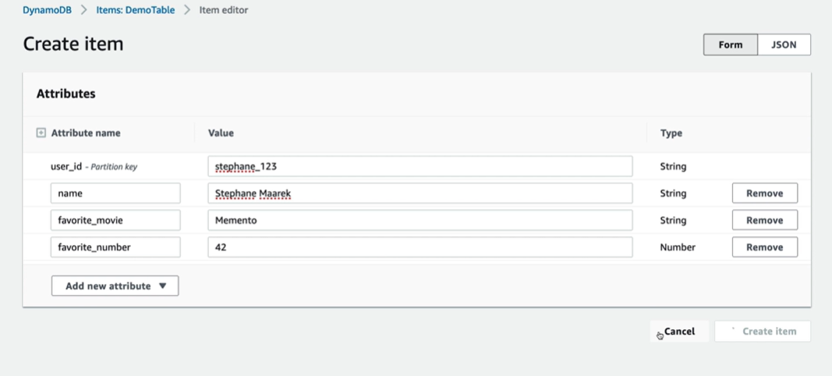
Create an item

Slide 34
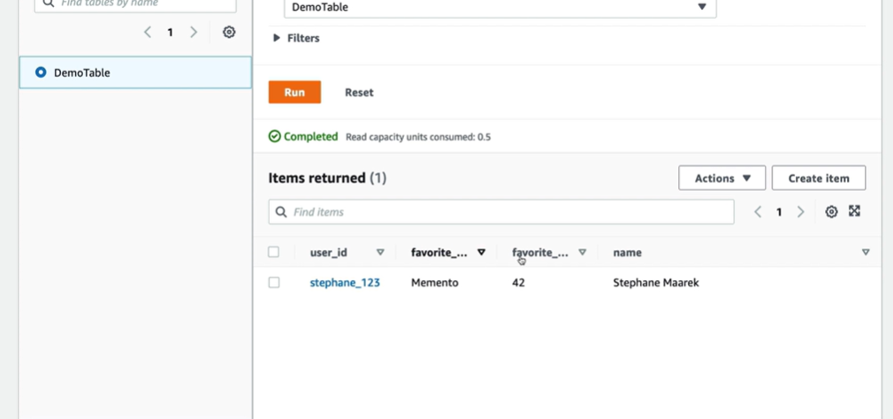
Can observe the item is inserted

Slide 35
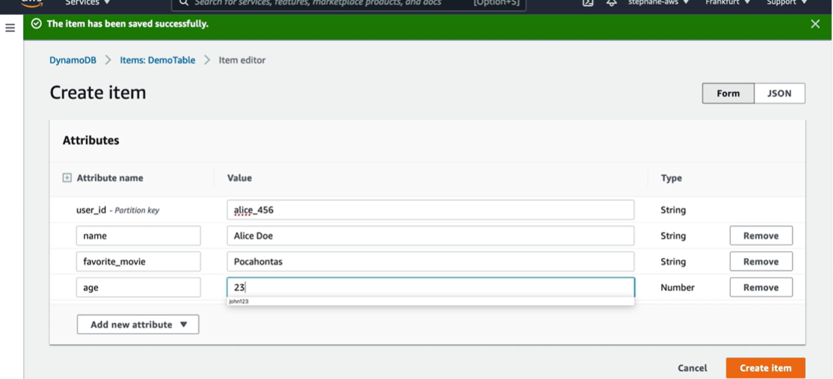
Create an another item

Slide 36
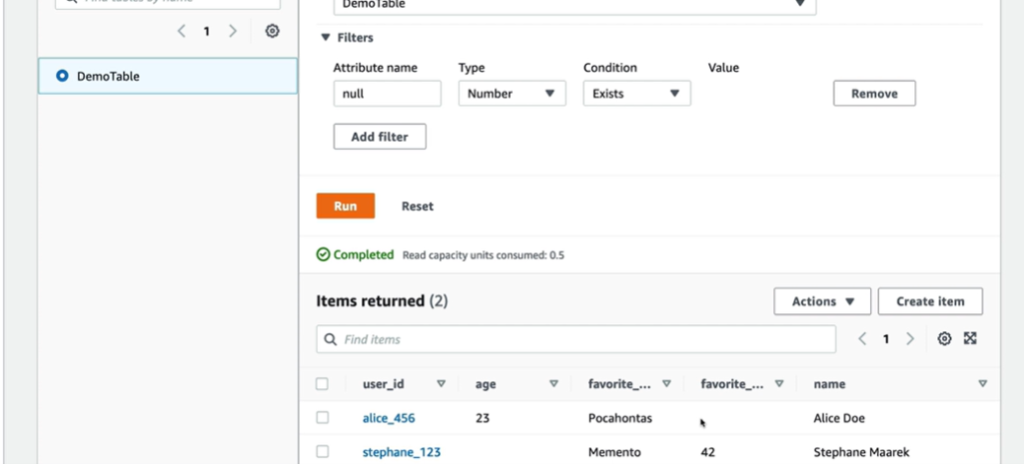
Can observe 2 different row values

Slide 37
DynamoDB is a NoSQL type of database
No need to fill all the attributes similar to SQL database tables

